Slide 1
Healthcare Advisor Chatbot
Contributor:
Thomas Do
Contributor:
Joe Lorizio
Contributor:
Jordan Garcia

Slide 2
Purpose
To create a chatbot that offers trustworthy, easy-to-understand health information based on a person’s specific concerns
Provide symptom-based guidance
Provide relevant healthcare information

Slide 3
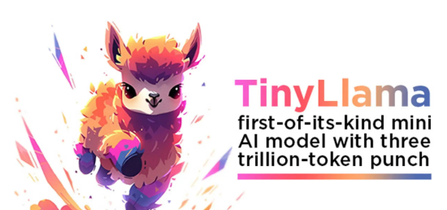
Pre-Trained LLM
TinyLlama is a smaller variation of the popular Llama language model
It was trained on 3 trillion tokens over 3 epochs which took 90 days
Despite its compact size TinyLlama outperforms other open-source models of similar scale

Slide 4
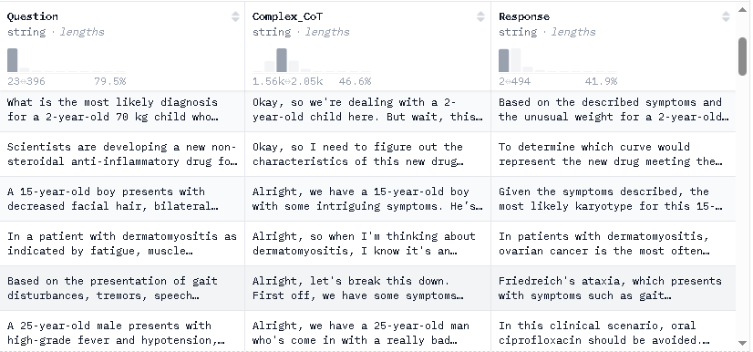
Training Dataset
The dataset we used is designed to fine-tune LLMs for advanced medical reasoning
It was constructed using GPT-4
Searches for solutions to verifiable medical problems and validates them through a medical verifier
https://huggingface.co/datasets/FreedomIntelligence/medical-o1-reasoning-SFT

Slide 5
Fine-tuning TinyLlama with PyTorch
Fine-tuning was done by training TinyLlama on the medical dataset to adapt it to the medical domain
During training, techniques like learning rate decay, freezing layers and gradient clipping were used to prevent overfitting

Slide 6
Evaluation Metrics
After fine-tuning the models performance was evaluated using BERTScore
For each token in the sentence, BERTScore finds the most similar token in the reference sentence using cosine similarity

Slide 7

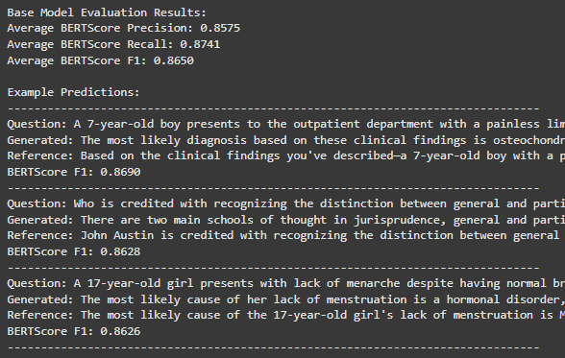
Model Results

Slide 8
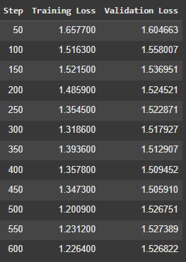
Model Results

Slide 9
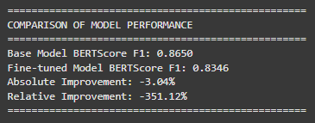
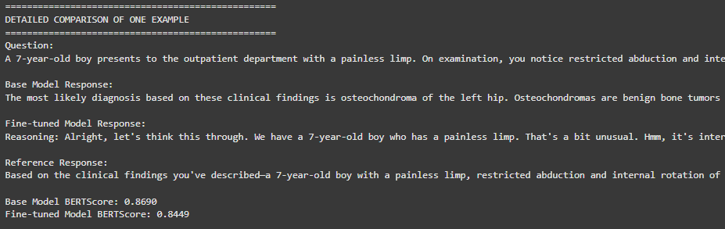
Model Results

Slide 10
Reference
FreedomAI. “FreedomIntelligence/Medical-O1-Reasoning-Sft · Datasets at Hugging Face.” FreedomIntelligence/Medical-O1-Reasoning-SFT · Datasets at Hugging Face, huggingface.co/datasets/FreedomIntelligence/medical-o1-reasoning-SFT. Accessed 6 Apr. 2025.

Slide 11
Thank you!

